Slide 1
DIGITAL LOGIC AND DESIGN
B.Tech(Honours)
CSE(AI/DS)
2nd semester
UTD, CSVTU, Bhilai

Slide 2
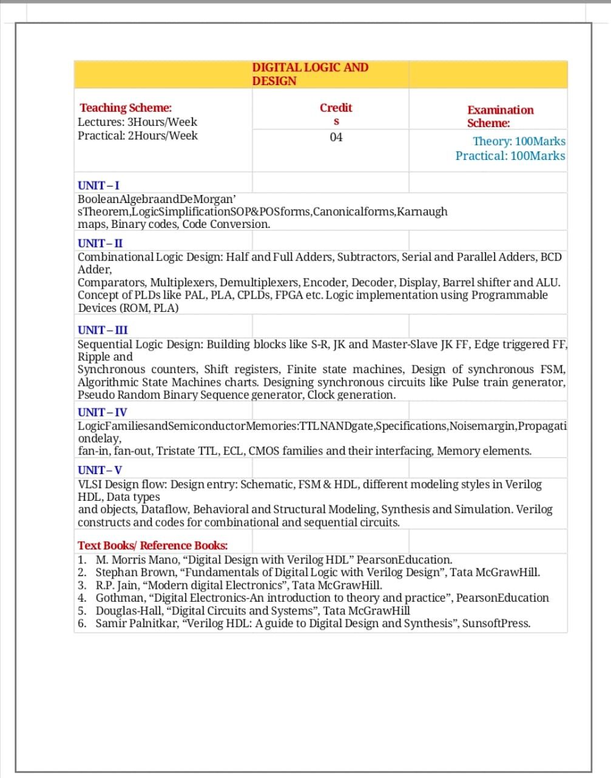

Slide 3
Unit 1-4
Books
R.P. Jain, Modern digital electronics
A.P. Godse, D.A. Godse, Digital Electronics and logic design
Unit 5
Morris Mano, Digital design with verilog HDL
Samir palnitkar, Verilog HDL

Slide 4
Online PDF books are available in following link ↓
https://www.google.com/url?sa=t&source=web&rct=j&url=https://z-lib.org/&ved=2ahUKEwjdt4zs3oL4AhUxxIsBHTuiBWAQFnoECAUQAQ&usg=AOvVaw317VYZRys6ni4wVkjbg8c0

Slide 5
CHAPTER – 01 BOOLEAN ALGEBRA
Unit 1

Slide 6
INTRODUCTION

Slide 7
INTRODUCTION
Developed by English Mathematician George Boole in between 1815 - 1864.
It is described as an algebra of logic or an algebra of two values i.e True or False.
The term logic means a statement having binary decisions i.e True/Yes or False/No.

Slide 8
APPLICATION OF BOOLEAN ALGEBRA

Slide 9
APPLICATION OF BOOLEAN ALGEBRA
It is used to perform the logical operations in digital computer.
In digital computer True represent by ‘1’ (high volt) and False represent by ‘0’ (low volt)
Logical operations are performed by logical operators. The fundamental logical operators are:
1. AND (conjunction)
2. OR (disjunction)
3. NOT (negation/complement)

Slide 10
AND operator
It performs logical multiplication and denoted by (.) dot.
X Y X.Y
0 0 0
0 1 0
1 0 0
1 1 1

Slide 11
OR operator
It performs logical addition and denoted by (+) plus.
X Y X+Y
0 0 0
0 1 1
1 0 1
1 1 1

Slide 12
NOT operator
It performs logical negation and denoted by (-) bar. It operates on single variable.
X X (means complement of x)
0 1
1 0

Slide 13
Truth Table
Truth table is a table that contains all possible values of logical variables/statements in a Boolean expression.
No. of possible combination =
2^{n}, where n=number of variables used in a Boolean expression.

Slide 14
Truth Table
The truth table for XY + Z is as follows:
Dec X Y Z XY XY+Z
0 0 0 0 0 0
1 0 0 1 0 1
2 0 1 0 0 0
3 0 1 1 0 1
4 1 0 0 0 0
5 1 0 1 0 1
6 1 1 0 1 1
7 1 1 1 1 1

Slide 15
Tautology & Fallacy
If the output of Boolean expression is always True or 1 is called Tautology.
If the output of Boolean expression is always False or 0 is called Fallacy.

Slide 16
Tautology & Fallacy

Slide 17
Exercise
1. Evaluate the following Boolean expression using Truth Table.
(a) X’Y’+X’Y (b) X’YZ’+XY’
(c) XY’(Z+YZ’)+Z’
2. Verify that P+(PQ)’ is a Tautology.
3. Verify that (X+Y)’=X’Y’

Slide 18
Implementation
Boolean Algebra applied in computers electronic circuits. These circuits perform Boolean operations and these are called logic circuits or logic gates.

Slide 19
Logic Gate

Slide 20
Logic Gate
A gate is an digital circuit which operates on one or more signals and produce single output.
Gates are digital circuits because the input and output signals are denoted by either 1(high voltage) or 0(low voltage).
There are three basic gates and are:
1. AND gate
2. OR gate
3. NOT gate

Slide 21
AND gate

Slide 22

AND gate
The AND gate is an electronic circuit that gives a high output (1) only if all its inputs are high.
AND gate takes two or more input signals and produce only one output signal.
Input A | Input B | Output AB
0 | 0 | 0
0 | 1 | 0
1 | 0 | 0
1 | 1 | 1

Slide 23
OR gate

Slide 24

OR gate
The OR gate is an electronic circuit that gives a high output (1) if one or more of its inputs are high.
OR gate also takes two or more input signals and produce only one output signal.
Input A | Input B | Output A+B
0 | 0 | 0
0 | 1 | 1
1 | 0 | 1
1 | 1 | 1

Slide 25
NOT gate

Slide 26

NOT gate
The NOT gate is an electronic circuit that gives a high output (1) if its input is low .
NOT gate takes only one input signal and produce only one output signal.
The output of NOT gate is complement of its input.
It is also called inverter.
Input A | Output A
0 | 1
1 | 0

Slide 27
PRACTICAL APPLICATIONS OF LOGIC GATES

Slide 28
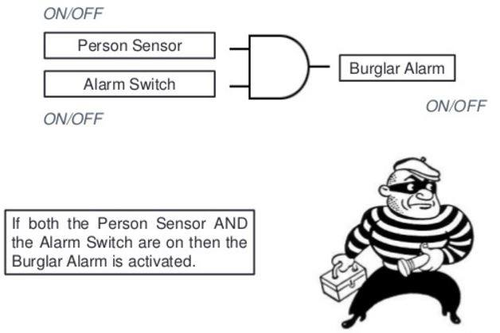
PRACTICAL APPLICATIONS OF LOGIC GATES
AND Gate
So while going out of the house you set the "Alarm Switch" and if the burglar enters he will set the "Person switch", and tada the alarm will ring.

Slide 29
PRACTICAL APPLICATIONS OF LOGIC GATES
AND Gate
Electronic door will only open if it detects a person and the switch is set to unlocked.
Microwave will only start if the start button is pressed and the door close switch is closed.

Slide 30
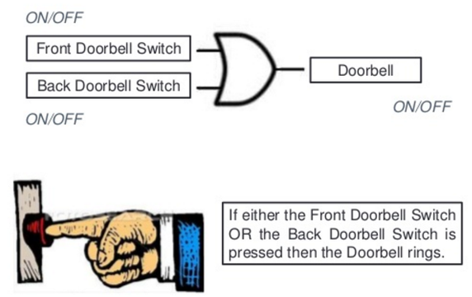
PRACTICAL APPLICATIONS OF LOGIC GATES
OR Gate
You would of course want your doorbell to ring when someone presses either the front door switch or the back door switch..(nice)

Slide 31
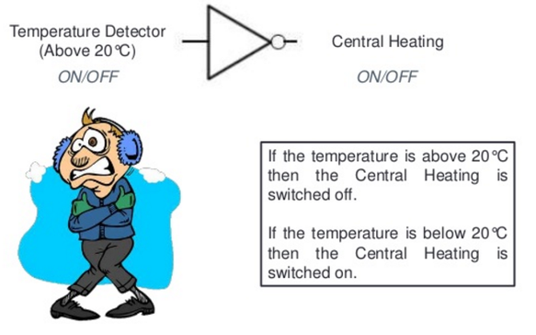
PRACTICAL APPLICATIONS OF LOGIC GATES
NOT Gate
When the temperature falls below 20c the Not gate will set on the central heating system (cool huh).

Slide 32
NAND, NOR XOR, XNOR GATES

Slide 33
NAND Gate
Known as a “universal” gate because ANY digital circuit can be implemented with NAND gates alone.

Slide 34
NAND Gate
NAND
X Y Z
0 0 1
0 1 1
1 0 1
1 1 0
X
Z
Y

Slide 35
NAND Gate
X
F = (X•X)’
= X’+X’
= X’
X
F = X’
X
X
F X•Y
F = ((X•Y)’)’
= (X’+Y’)’
= X’’•Y’’
= X•Y
Y
Y
X
X
F = (X’•Y’)’
= X’’+Y’’
= X+Y
F = X+Y
Y
Y

Slide 36
NOR Gate

Slide 37
NOR Gate
NOR
X Y Z
0 0 1
0 1 0
1 0 0
1 1 0
X
Z
Y

Slide 38
Exclusive-OR Gate

Slide 39
Exclusive-OR Gate
XOR
X Y Z
X
Z
0 0 0
Y
0 1 1
1 0 1
1 1 0

Slide 40
Exclusive-NOR Gate

Slide 41
Exclusive-NOR Gate
XNOR
X Y Z
X
Z
0 0 1
Y
0 1 0
1 0 0
1 1 1

Slide 42
Basic Theorem of Boolean Algebra
T1 : Properties of 0
(a) 0 + A = A (b) 0 A = 0
T2 : Properties of 1
(a) 1 + A = 1 (b) 1 A = A

Slide 43
Basic Theorem of Boolean Algebra
T3 : Commutative Law
(a) A + B = B + A (b) A B = B A
T4 : Associate Law
(a) (A + B) + C = A + (B + C) (b) (A B) C = A (B C)
T5 : Distributive Law
(a) A (B + C) = A B + A C (b) A + (B C) = (A + B) (A + C)
(c) A+A’B = A+B

Slide 44
Basic Theorem of Boolean Algebra
T6 : Indempotence (Identity ) Law
(a) A + A = A (b) A A = A
T7 : Absorption (Redundance) Law
(a) A + A B = A (b) A (A + B) = A

Slide 45
Basic Theorem of Boolean Algebra
T8 : Complementary Law
(a) X+X’=1
(b) X.X’=0
T9 : Involution
(a) x’’ = x
T10 : De Morgan's Theorem
(a) (X+Y)’=X’.Y’
(b) (X.Y)’=X’+Y’

Slide 46
De Morgan's Theorem

Slide 47

De Morgan's Theorem 1
Theorem 1 A . B = A + B

Slide 48
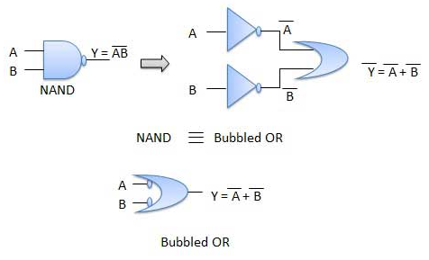
De Morgan's Theorem 1
Theorem 1 A . B = A + B

Slide 49
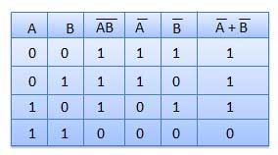
De Morgan's Theorem 1
Theorem 1 A . B = A + B

Slide 50
De Morgan's Theorem 2
Theorem 1 A + B = A . B

Slide 51

De Morgan's Theorem 2
Theorem 2 A + B = A . B

Slide 52
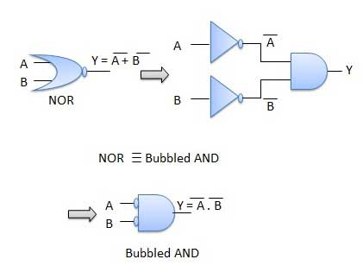
De Morgan's Theorem 2
Theorem 2 A + B = A . B

Slide 53
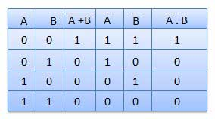
De Morgan's Theorem 2
Theorem 2 A + B = A . B

Slide 54
Thank You

